Slide 1


Slide 2


POLICY FORUM
Rethinking Irish Economic Development
WIFI ACCESS
UCC Guests
username: policyforum-nov-17
password: Xqqxkj6q
FOLLOW THE FORUM
#PolicyForum
@CUBSucc
www.cubsucc.com/re-thinking-irish-economic-development

Slide 3
Irish Cluster Policy:
A Discredited Idea or the Way Forward?
Eleanor Doyle
Competitiveness Institute, Dept. of Economics,
Cork University Business School, UCC.
Policy Forum UCC
November 3rd 2017

Slide 4
Context …
Clusters – background & current picture
How Cluster Policy is Developed & Implemented
National Cluster picture
Some local issues

Slide 5
Cluster
geographic concentrations of interconnected companies, specialised suppliers, service providers, firms in related industries, and associated institutions (for example universities, standards agencies, and trade associations) in particular fields that compete but also co-operate (1990; 1998 p197)

Slide 6
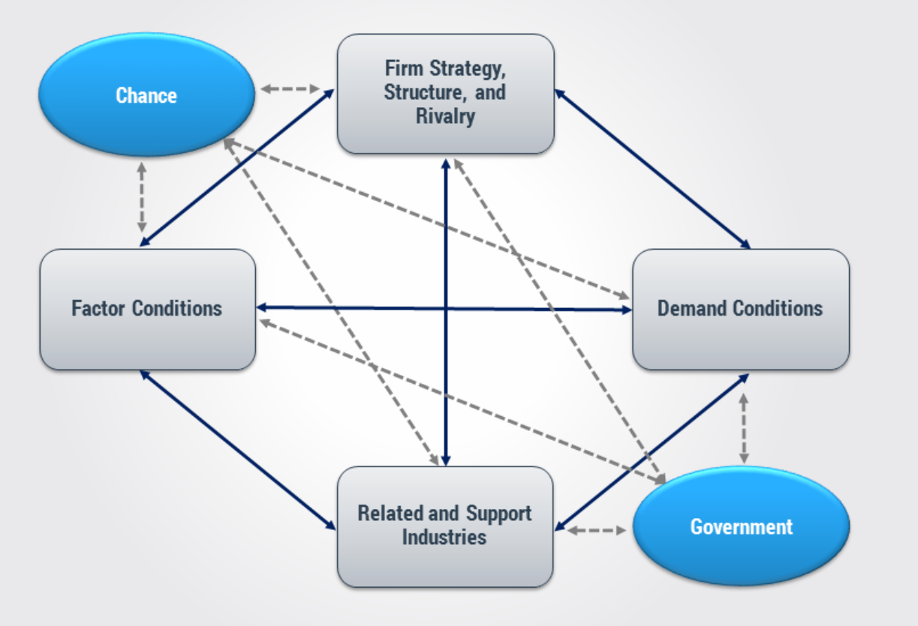
If Cluster is answer … what’s the Question?
Observation: success of places in specific activity i.e. international exporting success
  Cluster outcome: set of conditions
Q: What set of conditions explain a location’s success in internationally successful activities?
  Strong clusters feature co’s
  - Higher productivity
  - Higher rate of start-ups
  - Higher innovation capacity

Slide 7
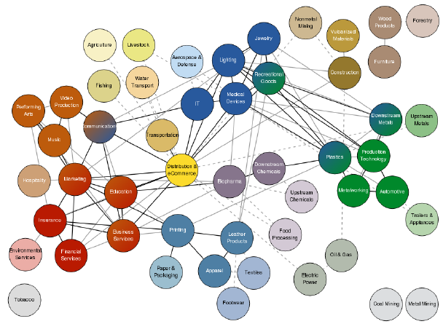
Cluster Activity Categories – 51 (ind + ser)
Co-location of employment & establishments | Similarities in skill use | Input-Output linkages (national) US Cluster Mapping Project

Slide 8

POLICY Evolution of Question
Q: How to improve locations’ competitiveness i.e. for internationally successful businesses?
A: Cluster Initiatives:
  organised effort to increase the growth and competitiveness of a cluster within a region, involving cluster firms, government and/or the research community (Sölvell et al., 2003).
  Bridge Builders ….

Slide 9

POLICY - Cluster Initiatives & Bridge Building
IDENTIFY GAPS & TARGET INTERVENTIONS
Cluster businesses: firm to firm local;
Firm-to-Research, firms, research laboratories & HEIs;
Firm-to-Education, i.e. education providers;
Firm-to-Capital, investors - banks, venture capitalists & business angels;
Firm-to-Public actors, exchange between firms and government incl. gov. agencies;
Firm-to-Cluster, exchange with other clusters;
+ Firm-to-Global markets & value chains.

Slide 10
POLICY - Cluster Initiatives & Bridge Building
IDENTIFY GAPS
TARGET INTERVENTIONS
Cluster businesses: firm to firm local;
Firm-to-Research, firms, research laboratories & HEIs;
Firm-to-Education, i.e. education providers;
Firm-to-Capital, investors - banks, venture capitalists & business angels;
Firm-to-Public actors, exchange between firms and government incl. gov. agencies;
Firm-to-Cluster, exchange with other clusters;
+ Firm-to-Global markets & value chains.
Once market test passed????

Slide 11
CI: Wide Potential of Objectives, Scope, Tools …
HR upgrading
Cluster expansion
Internationalization
Commercial cooperation
Innovation
Business environment
collective knowledge management & exploitation strategy
From Surveys of European Cluster Managers (2008, 2012, 2015)

Slide 12
Cluster Policy
Set of policy interventions aiming at strengthening existing clusters or facilitating the emergence of new ones (European Commission, 2008: 28)
Delivered through Cluster Initiatives, Cluster Organizations, Cluster Managers

Slide 13
Cluster Policy Approaches
Most important regional strategy for EU 7th Framework Programme (€8bn+ R&Inn. 2007-13)
  Germany: Regional gov. cluster policy mid 2000s
  Austria: Clusterland 1997 – 7 clusters state driven;
  France: competitiveness poles, mix of spatial, regional development & tech. policy (+Holland)
  Finland: tech & innovation policy – region level.
  Ireland …. Enterprise 2025 (nascent; sector/cluster); Innovation 2020 (clusters of research centres; HEIs);
    DJEI Briefing doc – clusters related to sectors

Slide 14
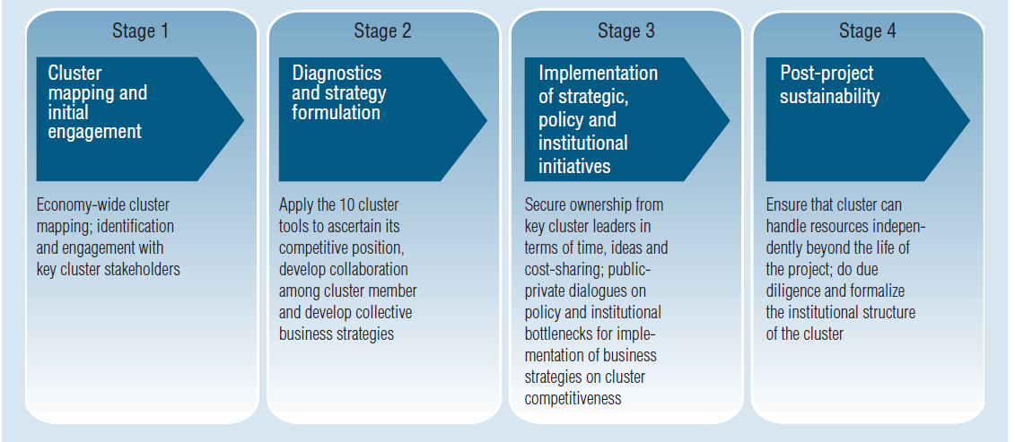
Phases in Developing Cluster Policy (Initiatives)
World Bank Approach (2009)

Slide 15
European Cluster Programmes: Findings & Trends 2015
Fewer countries with dedicated cluster programmes relative to 2008. Scope towards regional development & innovation.
Cluster programmes more selective – targeting mature, world-class and emerging industries.
Cluster management excellence focus across all programmes.
Supports for Internationalisation important in most programmes.
Increasing professionalization of cluster and development of business support services as non-monetary supports.
Majority of cluster programmes are well linked to national or regional specialization or innovation strategies
Meier zu Koecker, G. and Mueller, L. (2015) Cluster Programmes in Europe, European Cluster Observatory Report.
Notes:
To

Slide 16
Ireland - Policy
Revising national cluster policies and programmes and putting new programmes in place.
  Evidence in the Action Plans for Jobs (2017) which identify specific areas of focus for different regions
Change in Focus
To qualify for funding via EU 8th framework (Horizon 2020) countries required to have Regional Innovation Strategies for Smart Specialisation
Ireland used a National Research Prioritization Exercise (NRPE) initiated in 2010 for the RIS3 submission

Slide 17
Clusters & Regions

Slide 18
Ireland: Cluster Categories
O’Connor, Doyle & Brosnan, 2017

Slide 19
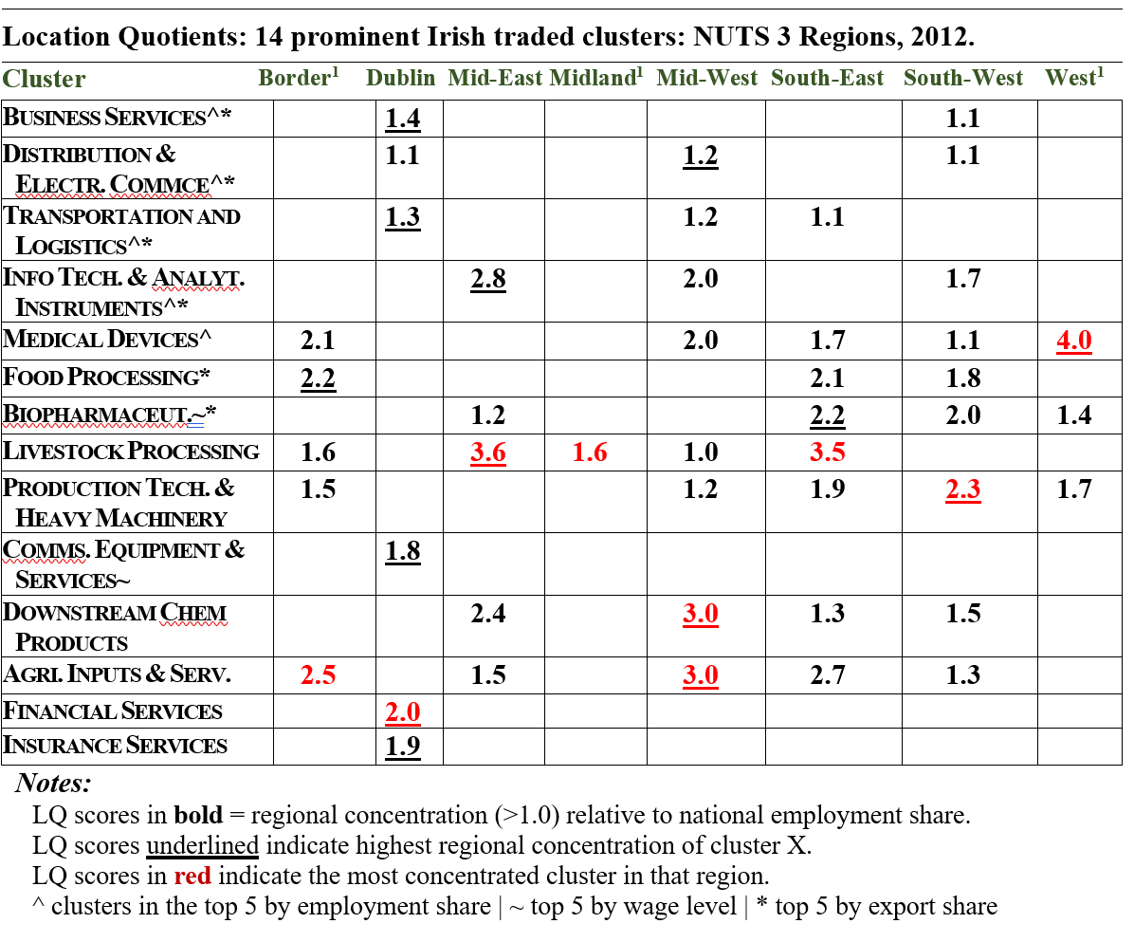
Ireland: Regional Clusters
O’Connor, Doyle & Brosnan, 2017

Slide 20
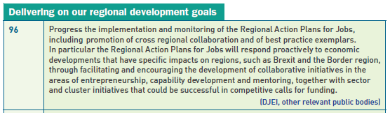
Irish Cluster Policy
Ireland has not done cluster policy (initiatives …)
8 mentions in APJ ’17: Grow sectoral clusters (p41: p70)
Meaningful development / implementation

Slide 21
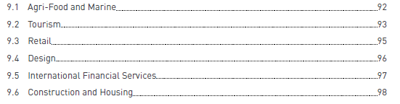


Chap 9: Strengthening Clusters

Slide 22
Cluster Policy Ireland?
Bottom-up, decentralized approach of Cluster Initiatives. Region perspective & outward focussed
Historically, answering a different question. Building FDI further ….
BUT revising National Cluster Policy … can
  Develop further connections for exporting SMEs
  See cluster boundaries beyond Ireland
APJ - Using cluster outside its meaning – not linked to national or regional specialization, RIS3, or innovation strategies.
Could use revision of National Policy to bring greater coherence across policy range – innovation, regional development, via regions.

Slide 23
Questions, Comments;
e.doyle@ucc.ie

Slide 24
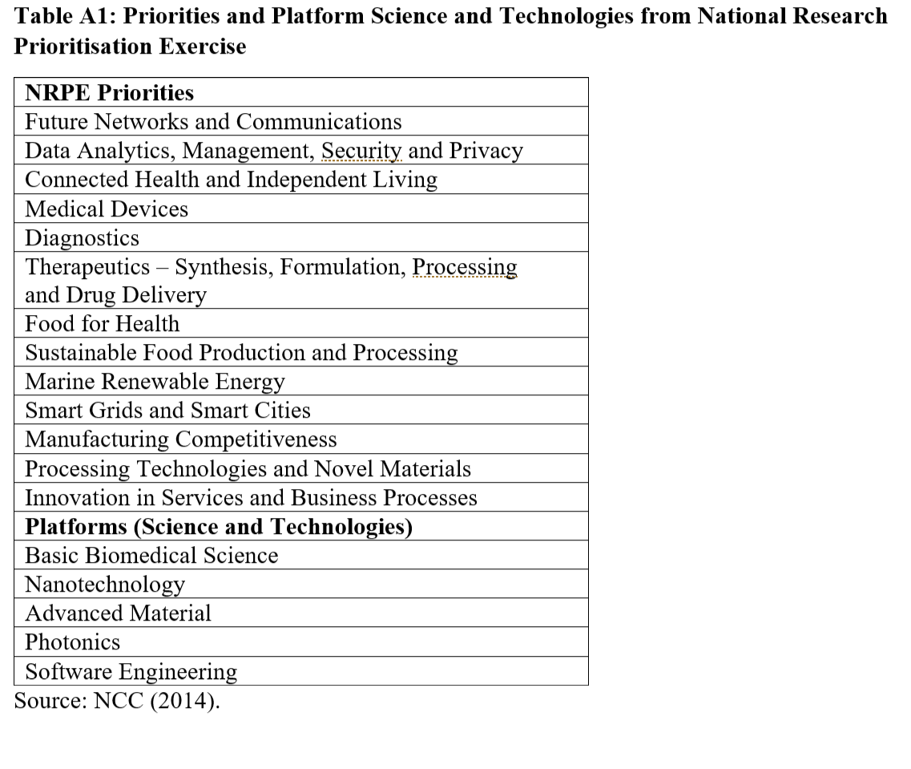

Slide 25
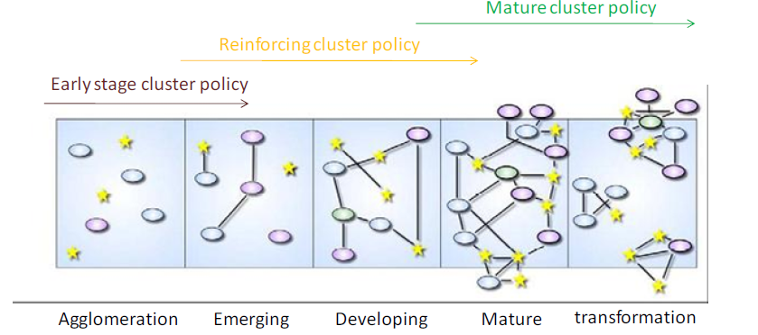
Latest Policy Evolution:
Q: How to account for cluster stage in improving locations’ competitiveness?

Slide 26
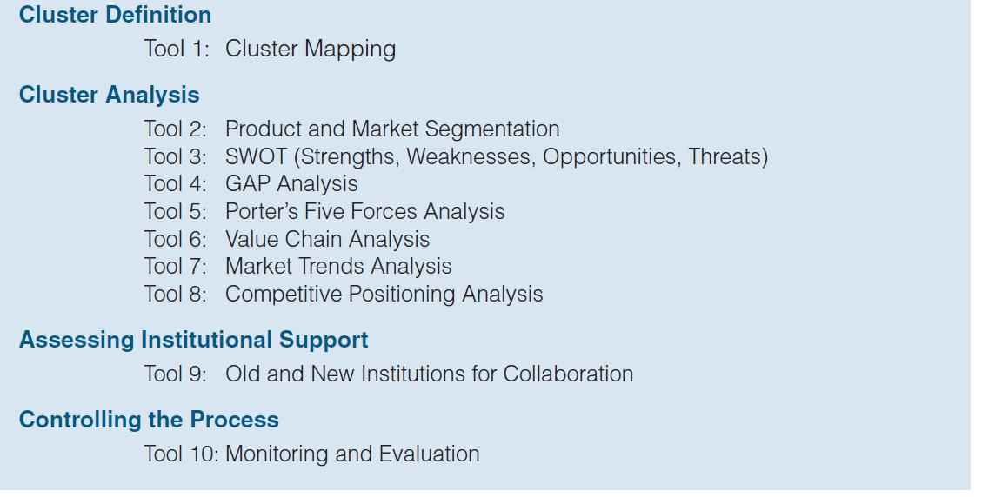
Tools in Cluster Initiatives
World Bank Approach

Slide 27
POLICY FORUM
Rethinking Irish Economic Development
WIFI ACCESS
UCC Guests
username: policyforum-nov-17
password: Xqqxkj6q
FOLLOW THE FORUM
#PolicyForum
@CUBSucc
www.cubsucc.com/re-thinking-irish-economic-development

